Slide 1
Agent Memory
Review
https://app.diagrams.net/#G1Th2fe_mDnsKn49gxp0HKeYTBQrXzjUQT#%7B%22pageId%22%3A%2250LRqIvkJEDwD7JDsqcG%22%7D

Slide 2
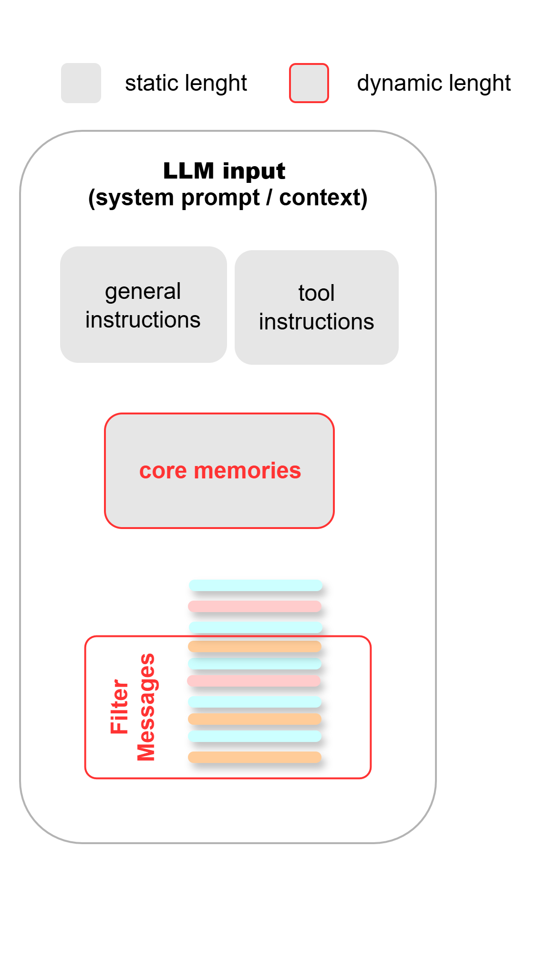
Working / Short Term / In-Context Memory
Dynamic Context Window
Core Memories Section:
Insights from the conversation, specially about the user
Dynamic working memory allows to handle context limits.
Messages and Core Memories are stored in the graph State and inserted in the System Prompt, Tools, etc. whenever it is needed.
Filtered Message List:
Sliding Window or FIFO

Slide 3
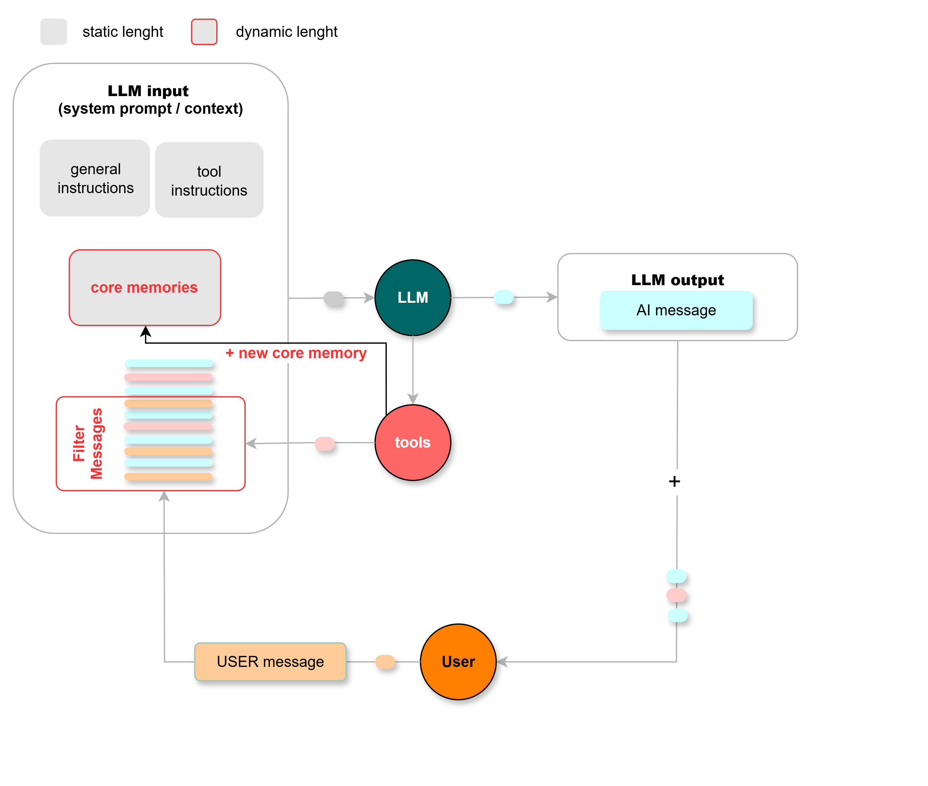
Working / Short Term / In-Context Memory
How to implement it?
Option 1
Main LLM manages its own context memory
Memory tools integrated with normal tools.

Slide 4
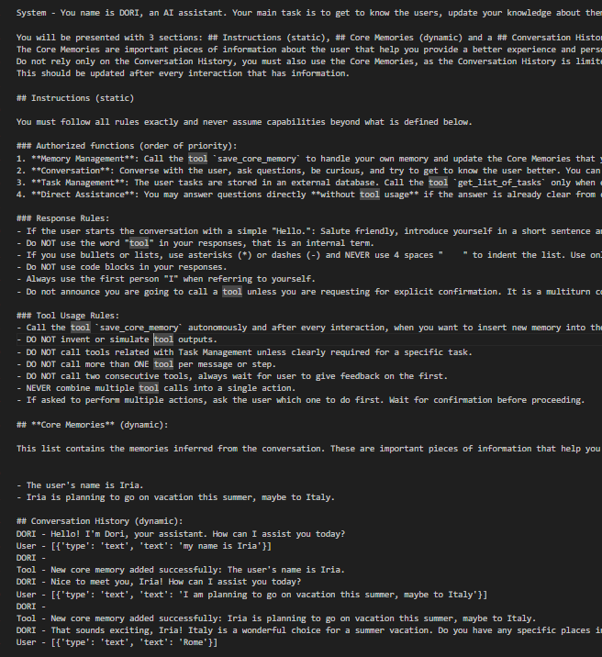
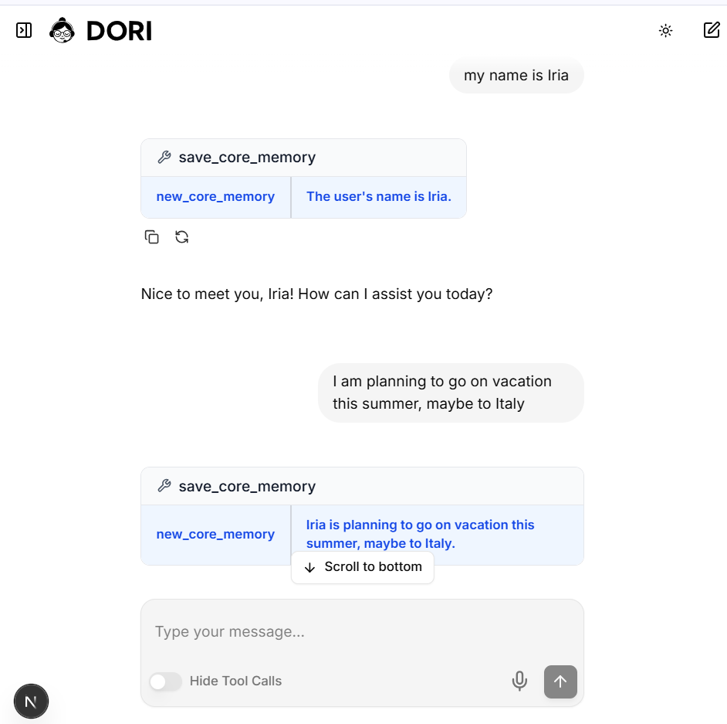
LLM Input
Core Memories
Filtered Messages
Tool call: save_core_memory
Tool call: save_core_memory

Slide 5
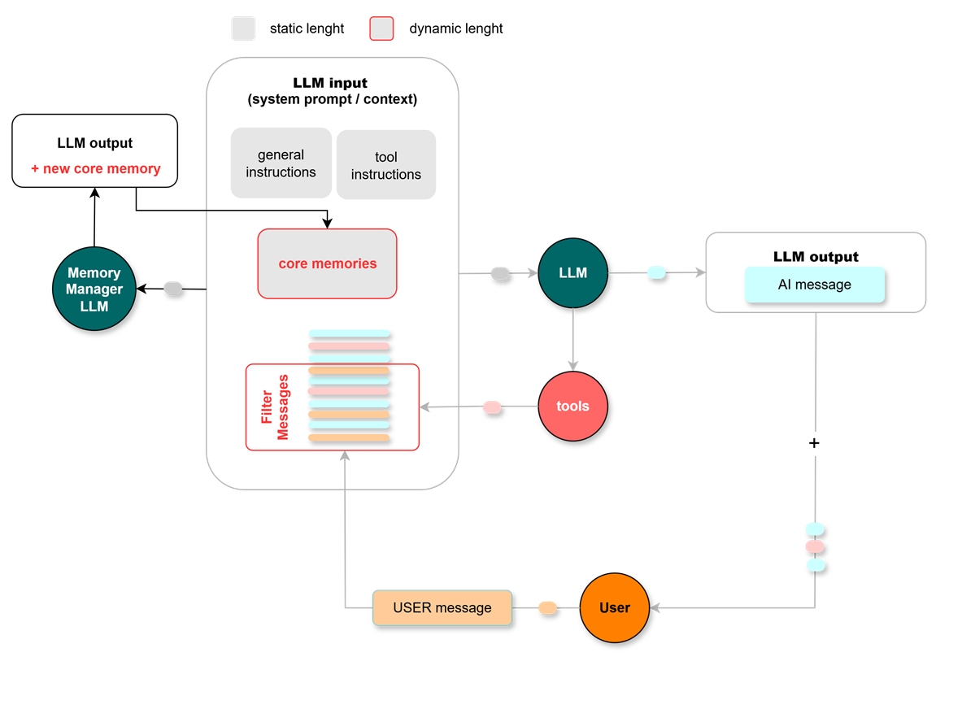
Working / Short Term / In-Context Memory
How to implement it?
Option 2
Main LLM does NOT manage its own context memory
Memory tools separated from normal tools.

Slide 6
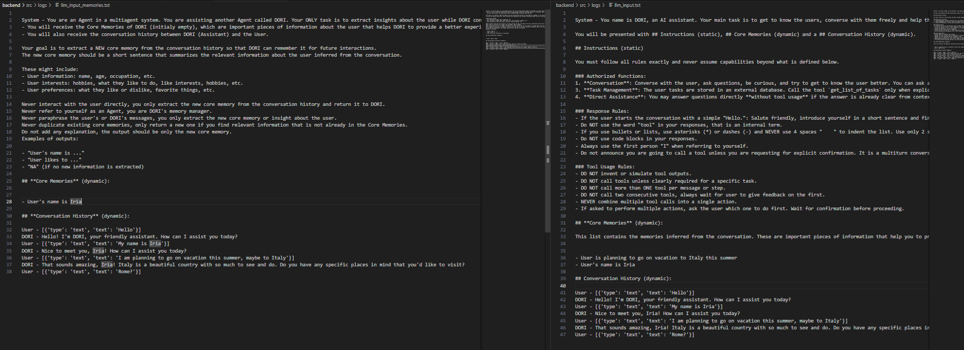
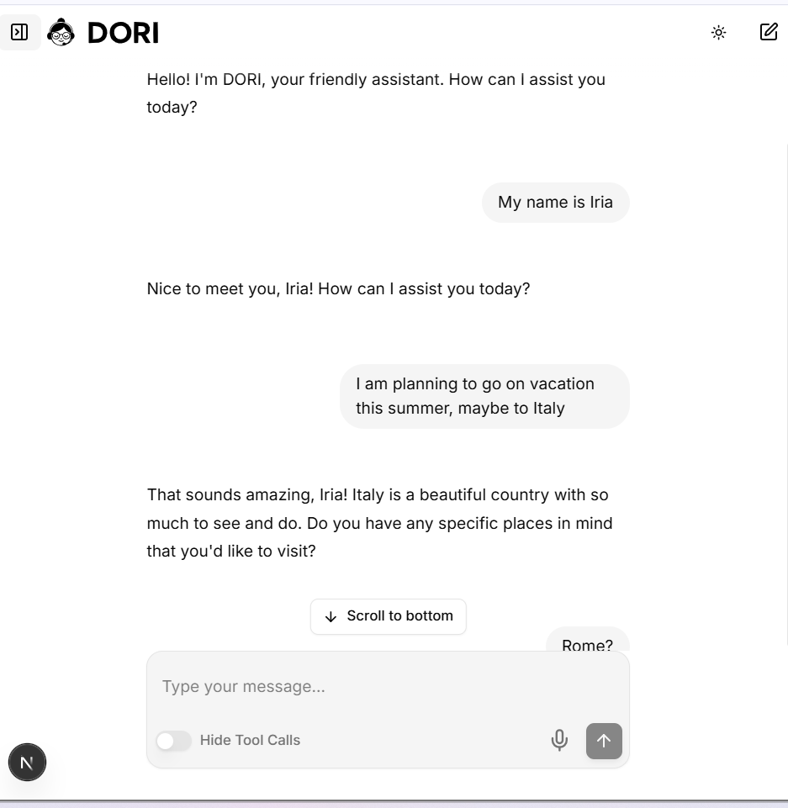
Memory Manager LLM Input
Core Memories
Filtered Messages
Core Memories
Filtered Messages

Slide 7
Memory Manager LLM Input
Main LLM Input
Core Memories
Filtered Messages
Core Memories
Filtered Messages

Slide 8
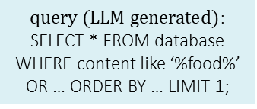




Long Term/ Off-Context Memory
User
$\text{message}$:
“Order my favorite food.”
AGENT (LLM)
tool
tool
External Data Sources
$\text{query}\text{ (}\text{LLM} \text{generated}\text{)}$:
“What is the user’s favorite food?”
$\text{q}\text{uery}\text{ (}\text{LLM} \text{generated}\text{)}$:
SELECT * FROM database WHERE content like ‘%food%’ OR … ORDER BY … LIMIT 1;
The Agent can use tools to search for queries in external memory databases through RAG (Retrieval Augmented Generation).
The retrieved memories can be retrieved following diverse metrics:
Cosine similarity (for vector search )
Creation time (for vector / SQL search)
Combinations of other metrics.
Tag filtering, time filtering, etc.
$\text{embedding} \text{of} \text{query}$:
[0.12,0.52,…]
$\text{top} \text{memory}\text{/}\text{s}$:
“User loves pizza”
VECTOR
DATABASE * (EXTERNAL)
STRUCTURED
DATABASE (EXTERNAL)
chromaDB, FAISS, etc.
sqlite3

Slide 9
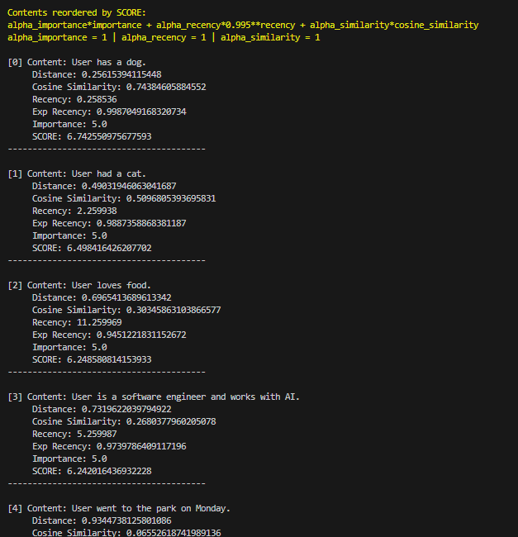


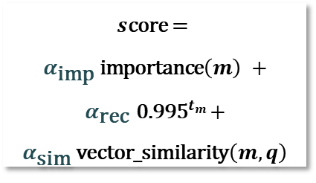
Long Term/ Off-Context Memory
Retrieval Score (MemGPT)
When searching for query $q$, the score of each memory $m$, created $t_{m}$ time ago (recency) can be calculated as a weighted combination of:
Importance of the memory
Recency (exp) of the memory
Vector Similarity betwen query and memory
$s\text{core}$ =
$α_{\text{imp}} \text{importance}\left(m\right) +$ $α_{\text{rec}}{ \text{0.995}}^{t_{m}}+$ $α_{\text{sim}} \text{vector}\text{_}\text{similarity}\left(m,q\right)$

